Slide 1
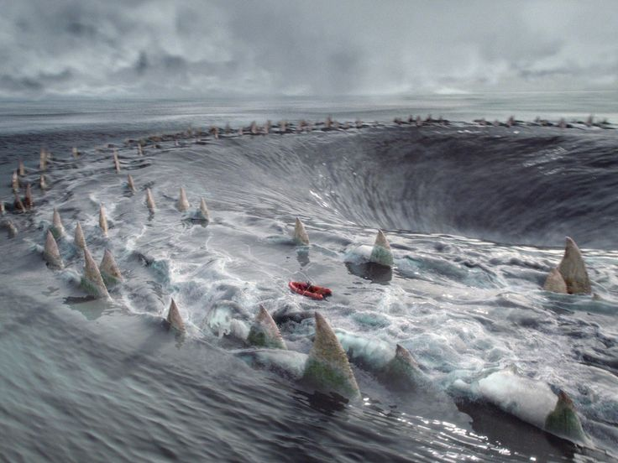

Slide 2
Beware Charybdis

Slide 3
Beware Charybdis
Unmet expectations

Slide 4
Beware Charybdis
Envy
Unmet expectations

Slide 5
Beware Charybdis
Envy
Unmet expectations
Resentment

Slide 6
Beware Charybdis
Envy
Unmet expectations
Resentment
Tilting
at Windmills

Slide 7
Beware Charybdis
Envy
Unmet expectations
Resentment
Tilting
at Windmills

Slide 8
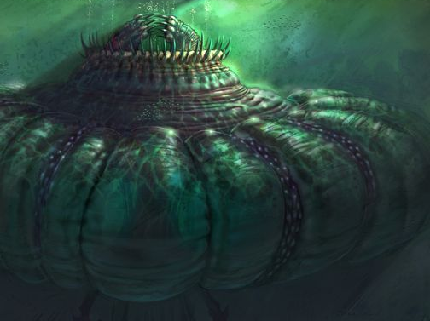
Charybdis
Tilting
at Windmills
Poisonousness
Bitterness

Slide 9
Beware Charybdis
Envy
Unmet expectations
Resentment
Tilting
at Windmills

Slide 10
Beware Charybdis
Envy
Unmet expectations
Resentment
Tilting
at Windmills

Slide 11
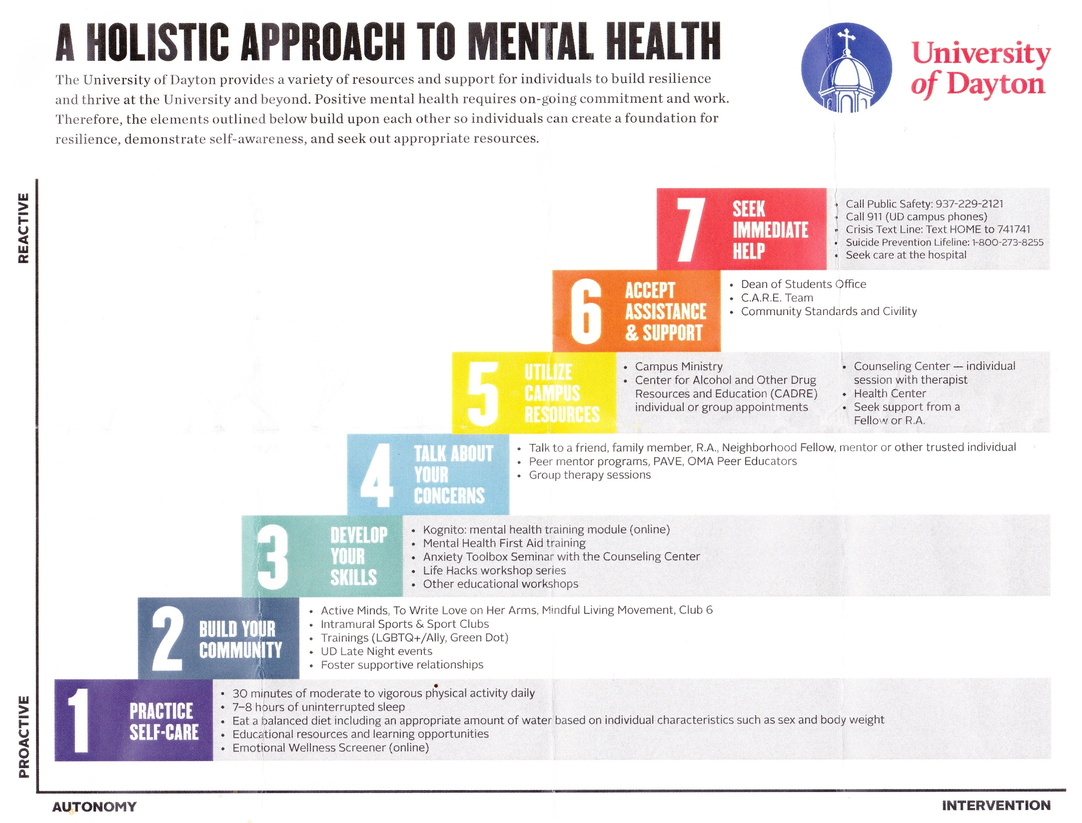

Slide 12
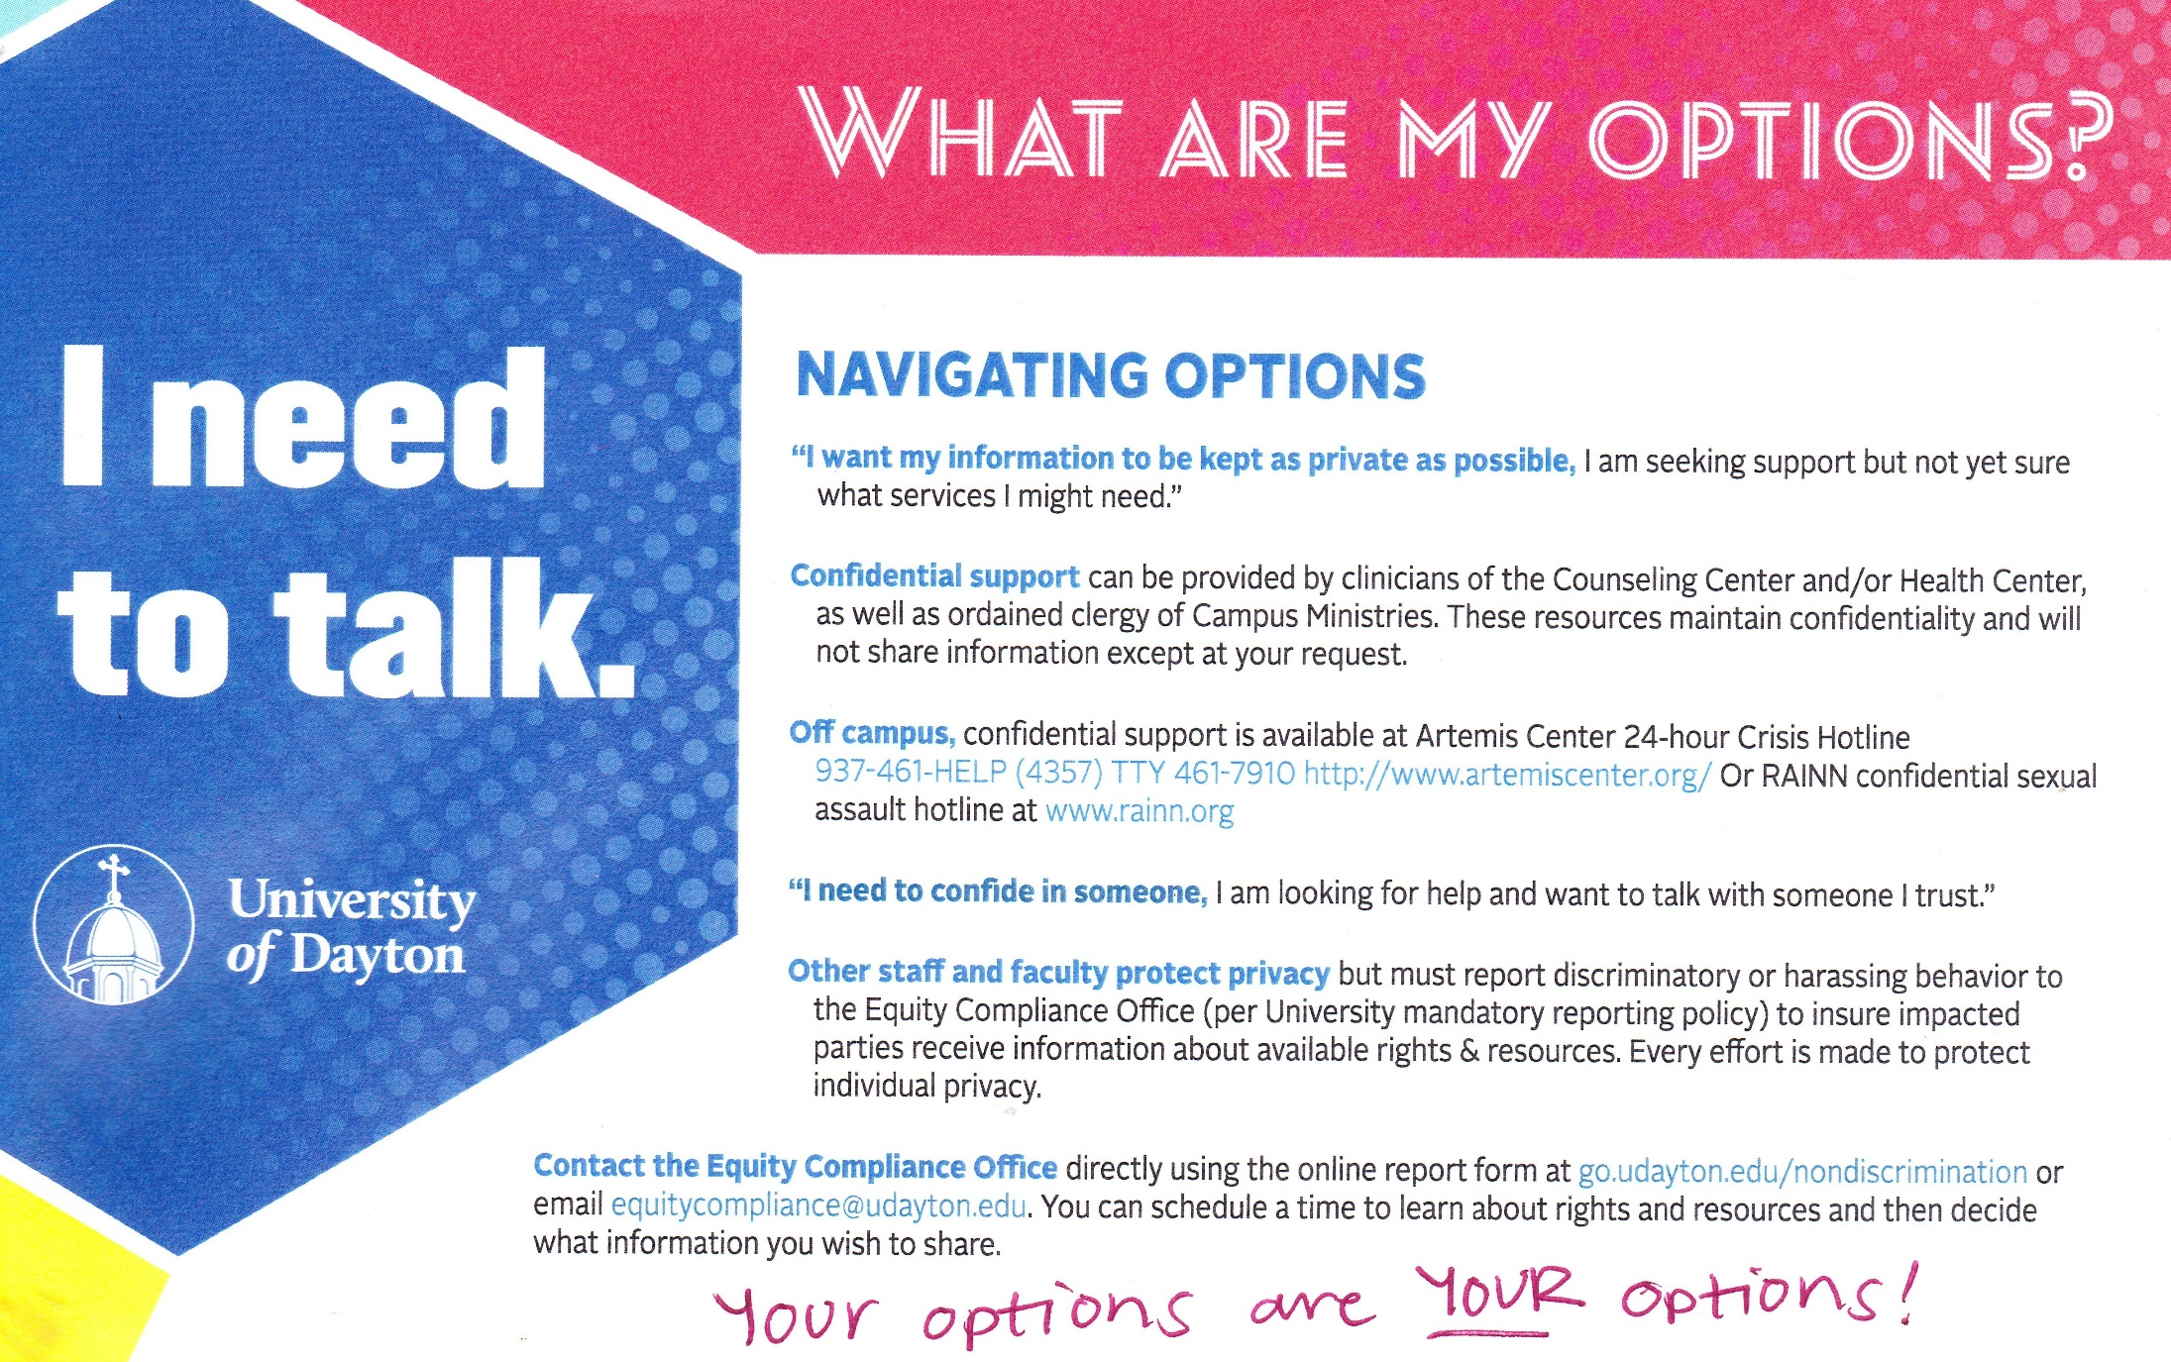

Slide 13


Slide 14
Beware Charybdis
Envy
Unmet expectations
Resentment
Tilting
at Windmills

Slide 15
Beware Charybdis
Envy
Unmet expectations
Resentment
Tilting
at Windmills
Gratitude

Slide 16
Beware Charybdis
Envy
Unmet expectations
Resentment
Tilting
at Windmills
Gratitude
Enthusiasm

